Slide 1
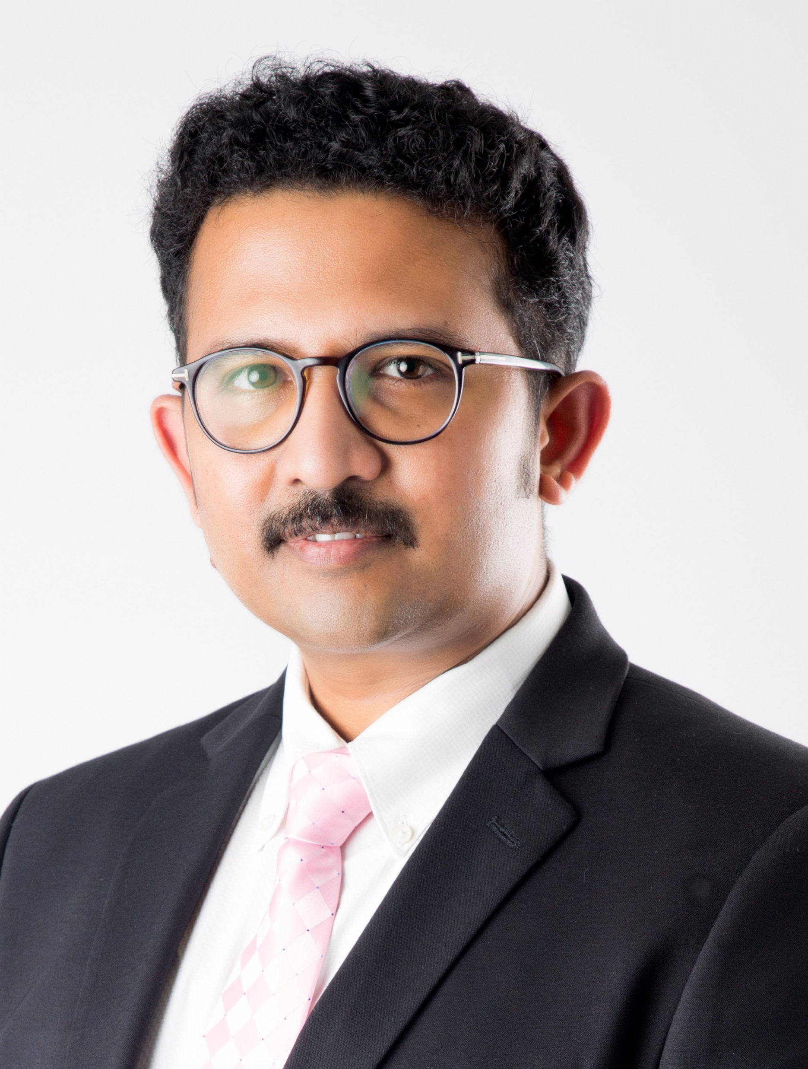
“About CAAD” page
Dr. Vinodh Vijayakumar,
B.Arch., M.Plan., (SAP), MAUD., (NUS, Singapore), Ph.D.
Dr. Vinodh Vijayakumar is the Director of CAAD- Chennai Academy of Architecture and Design, bringing over 15 years of leadership experience in higher education, with expertise in institutional development, collaborations, academic governance, and regulatory frameworks.
He has five years of international exposure, including postgraduate studies at the National University of Singapore and professional experience in Singapore, contributing to projects across Southeast Asia and China. This global perspective informs his approach to academic innovation and collaboration.
An accomplished academician, he holds two postgraduate degrees in Planning and Urban Design, along with a Ph.D., reflecting a strong commitment to research and academic excellence. He has consistently mentored faculty and students, contributing to improved university rankings and successful placements.
With a vision to build a progressive academic environment, he actively promotes innovative teaching practices, industry partnerships, and international collaborations.

Slide 2
Management
JAYA Group of Institutions
At Jaya Group of Institutions, the leadership believes that education is the foundation of transformation. Since our establishment in 1977, we have been dedicated to shaping brilliant minds, fostering innovation, and preparing students to thrive in a rapidly evolving world.
Our Journey
From a humble primary school to a renowned educational network with over 30 institutions, Jaya Group has been a pillar of academic excellence. With a commitment to quality education, research, and skill development, we have empowered thousands of students to become leaders, innovators, and change-makers across diverse industries.
What We Offer
Multi-disciplinary Education – Architecture, Engineering, Medicine, Technology, Business, Agriculture, Arts, Sciences, and more.
State-of-the-Art Facilities – Smart classrooms, advanced labs, libraries, and innovation centers.
Industry-Integrated Learning – Hands-on training with internships and placements.
Global Outlook – Research partnerships and exchange programs.
A Legacy of Excellence – Over four decades of skilled professional graduates.

Slide 3
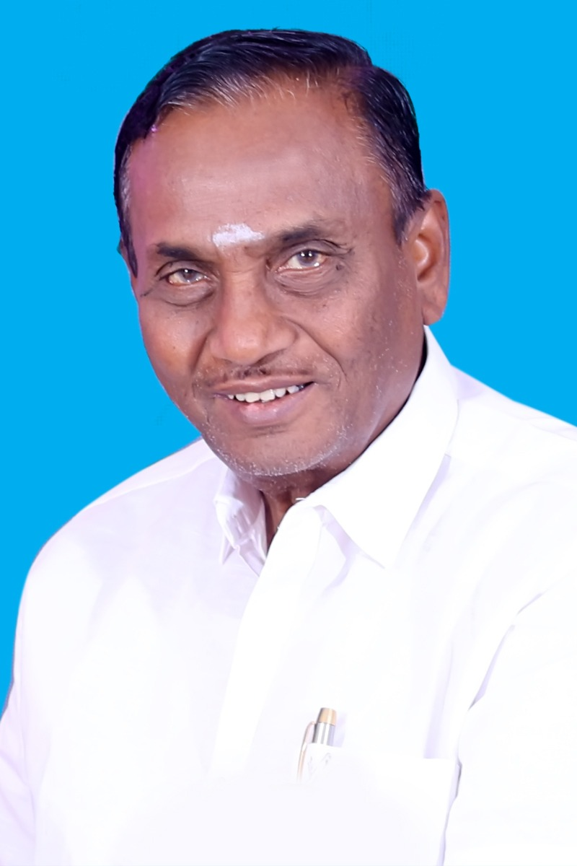
Management
Chairman Message
PROF. A. KANAGARAJ M.A., M.PHIL.
“Delightful task! to rear the tender thought;
To teach the young how to shoot;
To pour the fresh, instruction o’er the mind;
To breathe the enlivening spirit, and
to fix The generous purpose in the glowing heart”.
– Thomson, Sp. 1149
“Architecture begins with imagination and takes form through vision,” as the saying goes, at CAAD, we cultivate this spirit in aspiring architects—nurturing creativity, critical thinking, and the ability to shape meaningful spaces. In today’s dynamic and competitive landscape, we empower architecture students with refined design sensibilities, technical expertise, and innovative thinking.
State-of-the-art studios, advanced laboratories, dedicated faculty, vibrant design discussions, national and international workshops, and concept-driven projects form the strong foundation of our architecture education. Our committed mentors serve as guiding lights, inspiring students to transform ideas into impactful built environments.
With over 45 years of educational excellence of JAYA Group of Institutions, our institutions reflects deep academic insight and a legacy of shaping thoughtful, responsible, and accomplished professionals in architecture.

Slide 4
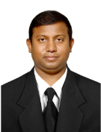
Management
Message from Vice-Chairman
Er. K.Navaraj, M.Tech., Ph.D.
“Mind has thousand eyes But the Heart with one yet the light of whole life done when the Education is in”
by adhering these words, our Jaya Group of Institutions the Educational Tree has its own branch and extending great shelter to Enthusiastic Professional Degree Candidates. It has great Milestone of Achievement in the ventures on various fields like Architecture, Medical, Dental, Paramedical, Aeronautic, Computer Science, Information Technology, Electrical and Electronic, Electronic and Communication, Civil, Textile and Mechanical Engineering. We are paying utmost interest over the standard of Education by the overseas experiences. Thereby we are building the castle of career set-up to the upcoming Professionals.

Slide 5
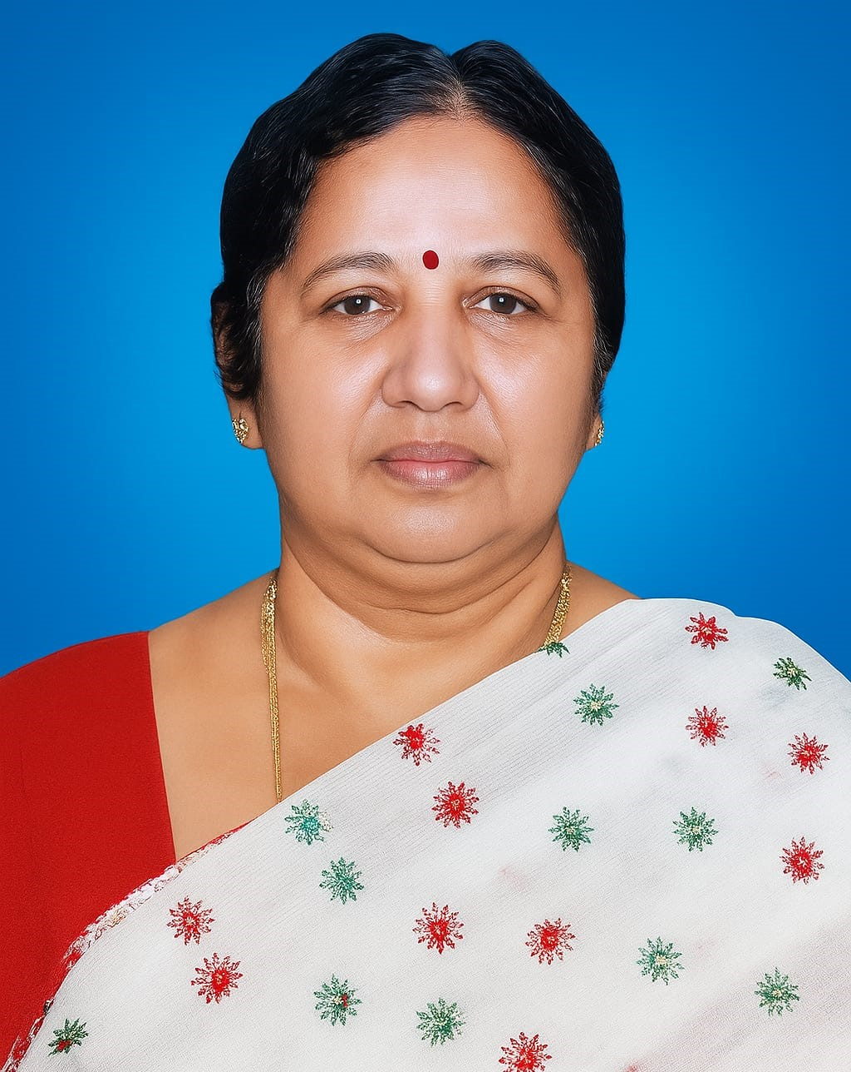
Management
Message from Secretary
Smt. K. Vijaya Kumari, M.A., B.Ed.
“To strive, to seek and to achieve — this is the age.”
This is the spirit we strive to instill in the hearts of our future professionals—creative thinkers who will shape the built environment across the world. At the Jaya Group of Institutions, we nurture a vision that extends beyond boundaries, empowering students to become global contributors in architecture and the wider creative industry.
We provide support for technical innovations and stimulate projects for global knowledge sharing. Like a mother nurturing her child toward success, we find immense pleasure in helping economically challenged but intellectually capable students through scholarships, sponsorships, bank loans, and endowment prizes. As the well-known proverb says, this is not an end, but a beginning. Our Jaya Group of Institutions will continue its educational service eternally.

Slide 6
Management
Message from Joint Secretary
Dr.K. DEENA, MBBS, MD
“Excellence is never an accident; it is always the result of high intention, determined effort and skilled execution” - Aristotle
We warmly welcome all aspiring architects to join CAAD at the Jaya Group of Institutions, and congratulate students and parents for choosing a path that shapes creative futures in architecture and design.
Our prime goal is to provide value added education on par with the standards of most sought-after educational institutes across the world. Being sought after by students and principal educators across the country and the globe, our institutions offer advanced academic programs with emphasis on practical and evidence based learning, thereby creating a conducive environment for gaining knowledge and skills. Our teaching learning methods are interactive, supportive, challenging and more rewarding for our students and provide a great chance to enhance their talents further. Besides imparting knowledge through quality education, we also inculcate other activities like sports, communication skills, performances and developing all other human qualities with the highest endeavor of our qualified faculty, pursuing international standard programs for our students.
The Faculty relentlessly work on preparing the generation next with the professional soft skills like communication and interpersonal skills that qualify them to become global leaders and valuable citizens in the years to come.

Slide 7
Director’s Message
Dr. Vinodh Vijayakumar,
B.Arch., M.Plan., (SAP), MAUD., (NUS, Singapore), Ph.D.
Director’s Message
At CAAD, we don’t just teach architecture—we shape future-ready professionals.
Architecture is a practice-driven discipline, and our learning model is built around real-world exposure, studio intensity, and industry relevance. From day one, students are trained to think, design, and perform like professionals ensuring they are fully prepared for the demands of the field upon graduation.
Our pedagogy is aligned with global standards, integrating advanced technologies, research-driven methodologies, and hands-on learning experiences. Students at CAAD evolve into technologically sound, highly articulate, and disciplined individuals, ready to excel across architecture and its diverse allied domains.
We strongly believe that great architects are not only skilled designers but also responsible thinkers. Through community-driven projects, travel-based learning, and collaborative studios, we nurture sensitivity, leadership, and a global outlook.
With a focused, outcome-oriented academic system, CAAD is committed to delivering career-ready graduates with strong placement outcomes. Every student is guided, mentored, and prepared to step confidently into the professional world.
Future-Ready Architects. Assured Outcomes.
At CAAD, your journey transforms you into an accomplished professional—and a remarkable individual.

